Slide 1
Triangulations Techniques in Mixed Research Method
Mehran Sepehri Sharif University of Technology, Iran
Industrial University of Tyumen Workshop for Graduate Students
Research Methods Basics
Mixed Research Method
Triangulation Techniques

Slide 2
Research Question
What?
When?
How?
Examples:
What people are in long-term unemployment?
How is long-term unemployment?
Why are they in long-term unemployment?
How can they be employed again?

Slide 3
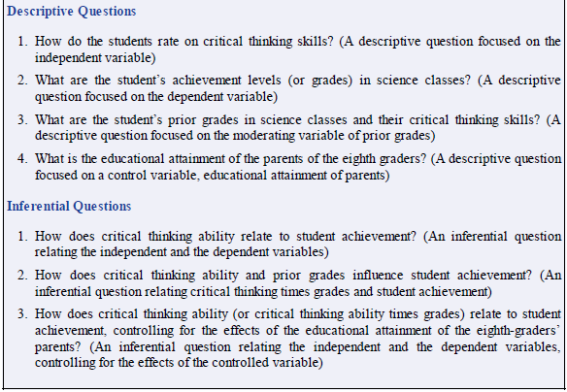

Slide 4
How would you combine two types of data?
Quantitative vs Qualitative
Each method serves a different purpose and is selected depending on what we want to know about behavior; researchers frequently combine both methods
Qualitative Text Data
This is a sample of a text file of words that might be collected on interview transcripts, observation field notes, or optically-scanned documents.
Quantitative Numeric Data
2 3 4 2 5 2 3 1 1 2 3 4 2 3 3 2 1 1 1 5 3 4 1 2 3 1 4 4 5 5 4 1 2 1 4 3 3 5 1 4 2 3 1 5 5 2 2 1 5 3 5 1 3 1 5 3 2 2 5 1 3 2 4 4 3 1 2 4

Slide 5
Quantitative and qualitative data analysis
Quantitative analysis
Use statistical analysis
For description
For comparing groups
For relating variables
Qualitative analysis
Use text and images
For coding
For theme development
For relating themes
Quantitative data
Experiments
Surveys
Data Collection
Instruments
Checklists
Qualitative data
Interviews
Observations
Documents
Audio-visual materials
Focus groups
Case Studies
Notes:
Quantitative analysis
Numeric data
Descriptive trend analysis
Hypothesis testing, effect size, interval estimates
Qualitative analysis:
Text/image data
Coding
Themes
Description
Interrelated themes to build a picture of the phenomenon.

Slide 6
Quantitative vs Qualitative
Quantitative data reveals generalizable information for a large group of people. These data often fail to provide specific answers, reasons, explanations or examples
Qualitative research provides data about meaning and context regarding people and environments of study. Findings are often not generalizable because of the small numbers and narrow range of participants
Both methods have strengths and weaknesses. When used together, these methods can be complimentary

Slide 7
Quantitative Methods
Narrow and focused
Objective
Artificial
Highly structured
Low ecological validity
Reliable
Low in reflexivity
Qualitative Methods
Provide a rich range of information
Subjective
Reflect the natural environment
Loosely structured or unstructured
High ecological validity
Low reliability
High in reflexivity

Slide 8
Strengths of Qualitative Research
Best choice for studying the context of a person (how a person makes meaning in a situation or documents a process)
Discovers the richness and complexities of real-life situations
It is the only way for studying certain behavior(s)
Addresses the limitations of quantitative methods
Limitations of Qualitative Research
Uncontrolled and hard to replicate
Low in population validity
Qualitative research is to portray the context of participants, we should not criticize the research for meeting its goals

Slide 9
Quantitative and Qualitative Sampling
Representative Sampling
Using a sample that represents a target population
Simple random sampling (SRS) and stratified random sampling
Only kind of sampling that allows for the generalization of study results (unless triangulation is used)
Non-representative Sampling
Opportunity sampling- used by most experiments
Purposive sampling- selecting a sample for a particular purpose; participants have particular characteristics (age, gender etc) based on a sample frame
Focus Groups
A group of experts on a topic or people with common experiences
Snowball Sampling
Interviewing an expert who then suggests the next expert participant

Slide 10
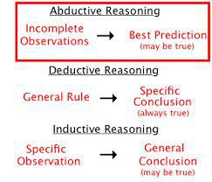
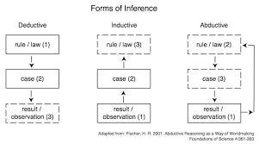
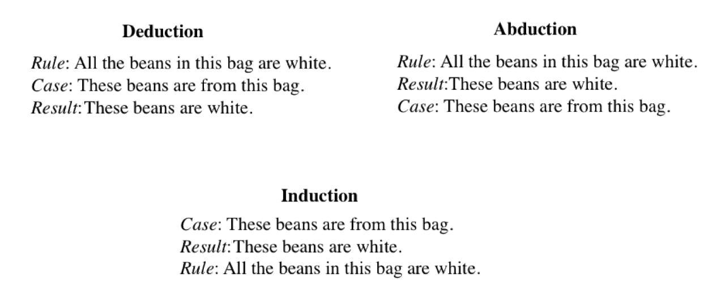

Slide 11
Relation to Theory
Theory Development
Theory Extension

Slide 12
Why are women from Venus and men from Mars?
John Gray (1996) tried to answer this question in his book but is his theory the best out there?
All current theories should have triangulated research before being accepted
Ethical Considerations in Qualitative Research
Informed consent
Anonymity and confidentiality
Participants protected from potential harm
Researchers protected from potential harm
Jane Lewis (2003)

Slide 13
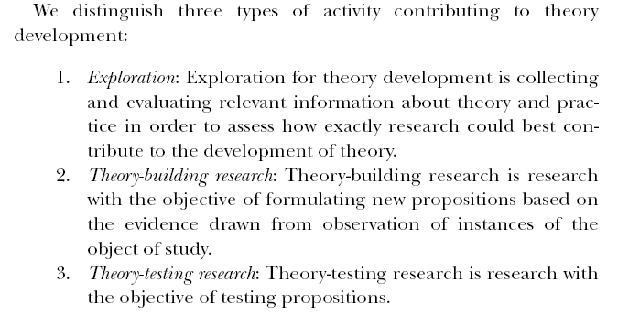

Slide 14
Sampling in Quantitative and Qualitative Research
Representative Sampling
Using a sample that represents a target population
Simple random sampling (SRS) and stratified random sampling
Only kind of sampling that allows for the generalization of study results (unless triangulation is used)

Slide 15
Sampling in Quantitative and Qualitative Research
Nonrepresentative Sampling
Opportunity sampling- used by most experiments
Purposive sampling- selecting a sample for a particular purpose; participants have particular characteristics (age, gender etc) based on a sample frame

Slide 16
Types of Purposive Samples
Focus Groups
A group of experts on a topic or people selected because of common experiences
Snowball Sampling
Interviewing an expert who then suggests the next expert participant and so on (Rosenthal, 1993)

Slide 17
Ethical Considerations in Qualitative Research
Informed consent
Anonymity and confidentiality
Participants protected from potential harm
Researchers protected from potential harm
Jane Lewis (2003)

Slide 18
Relational study
Research Typology
Identifying relationships between phenomena using survey methodologies and regression techniques
Survey methodology,
Multiple regression analysis,
Factor analysis,
Logistic regression,
Discriminant regression,
Structural Equation Modeling.
Introduction
Literature review
Theoretical framework (if needed)
Methodology
Data Analysis and discussion
Conclusion
References

Slide 19
2. Experimental study
Research Typology
Experimentation of the impacts of a phenomenon on other phenomena
Pre-experimental design,
True experimental design,
Quasi-experimental design,
T-test, ANOVA. MANOVA, MANCOVA techniques.
Introduction
Literature review
Theoretical framework
Methodology
Data Analysis & discussion
Conclusion
References

Slide 20
3. Theoretical study
Research Typology
A comprehensive review of the literature or a qualitative study to develop a new theoretical understanding of a phenomenon by developing new conceptual and/or theoretical frameworks
Deductive and integrative approaches to developing original theoretical and conceptual frameworks,
Using qualitative research approaches to developing ground theories.
Introduction
Literature review
Methodology (if qualitative research)
Data Analysis and discussion (if qualitative)
Theoretical model
Conclusion
References

Slide 21
5. Action Research
Research Typology
Examining outcomes of implementation of a plan and development of a model
Planning
Implementation
Evaluation
Introduction
Literature review
Implementation model
Evaluation Methodology
Data Analysis and discussion
Conclusion
References

Slide 22
4. Mathematical Modeling
Research Typology
Formulating a model into a mathematical model, with defined an objective(s) and constraints
Define Problem
Define Variable
State Hypothesis
Model Problem
Simplify if needed
Use Algorithm
Apply Simulation
Analyze Data
Make Conclusions
Introduction
Literature review
Problem definition
Model, objective(s)
Data analysis
Discussion
Conclusion
References

Slide 23
5. Case studies
A person: ….
A site: an organization – a country
An artefact: technology, product
Units of analysis in case studies:
Events, activities
Case study
A comprehensive, in-depth investigation of a situation, a sequence of activities, or a procedure within its natural setting
Purpose
To understand a situation, a sequence of activities, or a procedure to learn what happened, how it happened, and why it happened

Slide 24
Why a case study?
Investigate processes
Documenting an activity from first to last step
Investigate changes over time
Eg, changes in farm practices from Year 1 to Year 5
Participatory, involves experiential learning
Can lead to exchange of information between researcher and local people
Can emphasize local people’s perspective

Slide 25
Case study approach
researching an organism in its environment John Langrish
“Case study is the study of the particularity and complexity of a single case, coming to understand its activity within important circumstances.” Robert Stake (p xi)
“A case study is an empirical inquiry that investigates a contemporary phenomenon within its real-life context, especially when the boundaries between the phenomenon and context are not clearly evident.” Robert Yin p13
Single case study method,
Multiple case study method,
Combinations of quantitative qualitative research methods.

Slide 26
the case study approach
Case study is suitable for studying:
individuals and organisations; e.g.
consumers
communities
businesses
processes and periods of time; e.g.
managerial processes
consumer satisfaction
product supply chains
decision histories

Slide 27
Case study methodology
Case studies are used as a research tool to test hypotheses in an ex post facto manner ie when the researcher CAN NOT control ANY of the variables under investigation.
Case studies are therefore usually concerned with investigating how or why events occurred.

Slide 28
Variable-oriented Analysis
Focus of analysis is on interrelations among variables and the people observed would be the carriers of those variables.
Case Oriented Analysis
Analysis that aims to understand a particular case or several cases by looking at the details of each.
Cross-case Analysis
Analysis that involves an examination of more than one case, either a variable-oriented or case-oriented analysis.

Slide 29
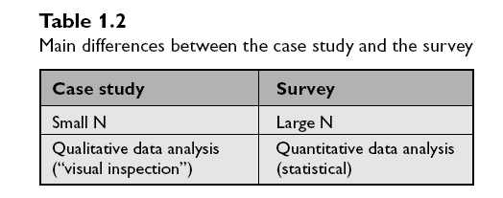
Case study vs. Survey
Rule of thumb: more variables than cases (<-> survey research: more cases than variables)
Relevant mechanisms, variables are not yet clear

Slide 30
Questionnaires/Interviews/Case study
Breadth
Questionnaire
Depth
Interview
Case Study
Breadth v Depth in Question-based studies

Slide 31
Grounded Theory Method
Four Stages:
Comparing incidents applicable to each category. i.e. conceptualizing ‘impatience’ and finding incidences of this.
Integrating categories and their properties; finding relationships among concepts. i.e. between gender and impatience
Delimiting the theory; getting rid of some of the concepts that you’ve found but that are not relevant. Focusing on others
Writing the theory.

Slide 32
Coding
In qualitative analysis the concept is the organizing principle for coding data
→ code categories are given to events, or texts or behavior that share a similar conceptual quality (for example ‘angry’)
→ this means that the same code could be given to materials of different sizes, lengths, or even types.
Codes can be decided by:
Theory
Open Coding (where common elements in data are discovered inductively).

Slide 33
Coding Text
Themes
or
Networks
“Selective Coding”
Families
Increasing Abstraction
“Axial Coding”
“Open Coding”
Interview Text
Case Study Workshop, 2007 John C. Bliss, Oregon State University

Slide 34
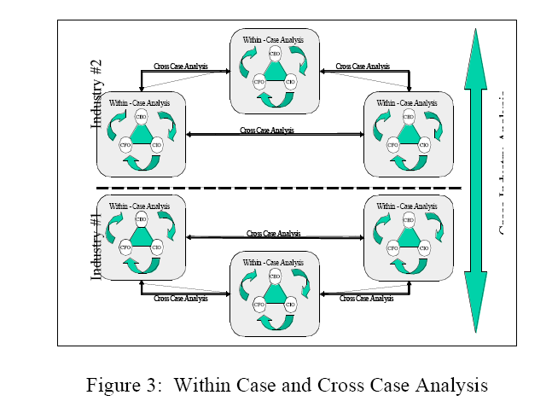

Slide 36
Workshop Part 1
Each group works on one particular problem
Management/Practical Problem?
Your particular research question?
Choose specific method (Quan./Qual.)?
Explain why chose the above method?
What are shortcomings of this method?
What is another method to compliment?

Slide 37
Mixed-m: Executive Summary
Mixed methods is a recent methodological development
There are different philosophical stances
We know the basic feature of this approach
Many techniques for conducting mixed methods research have developed
Mixed methods has grown into an interdisciplinary, world-wide movement
Yet, critics have emerged, and challenges exist
The future is positive, but there is work left to be done
Notes:
37

Slide 38
Mixed methods is not that different from other methods
Identifying a research problem
Reviewing the literature
Identifying a purpose and stating questions
Assumptions
Views of knowledge
Collecting data
Analyzing and interpreting data
Reporting and evaluating the study

Slide 39
Mixed Methods within Designs
Ethnography
Case Study Research
Narrative research
Experimental
research
Qual ----- Quan
Qual----- Quan
Qual-----Quan
Qual---- Quan

Slide 40
What is this Method Called?
Multi-method
Triangulation
Integrated
Combined
Quantitative and qualitative methods
Multi-methodology
Mixed methodology
Mixed-method
Mixed research
Mixed methods

Slide 41
A definition
Mixed methods research is both a method and methodology for conducting research that involves collecting, analyzing, and integrating quantitative and qualitative research in a single study or a longitudinal program of inquiry.
The purpose of this form of research is that both qualitative and quantitative research, in combination, provide a better understanding of a research problem or issue than either research approach alone.

Slide 42
Mixed methods is not that different from other methods
Identifying a research problem
Reviewing the literature
Identifying a purpose and stating questions
Assumptions
Views of knowledge
Collecting data
Analyzing and interpreting data
Reporting and evaluating the study

Slide 43
Mixed Methods within Designs
Ethnography
Case Study Research
Narrative research
Experimental
research
Qual ----- Quan
Qual----- Quan
Qual-----Quan
Qual---- Quan

Slide 44
Example. Human Development and Capability
Initial focus – new econometric models of regional development and development of indices of well being
Recent development – emphasis on participative methods because (a) important to develop concepts and constructs that better capture the diverse experiences of communities (b) ethical imperative to co-produce knowledge
Increasingly, recognise the importance of both approaches
Emerging Issue
How can these different traditions be combined in an academically rigorous manner?

Slide 45
What is the reason for using mixed methods?
The insufficient argument – either quantitative or qualitative may be insufficient by itself
Multiple angles argument – quantitative and qualitative approaches provide different “pictures”
The more-evidence-the-better argument – combined quantitative and qualitative provides more evidence
Community of practice argument – mixed methods may be the preferred approach within a scholarly community
Eager-to-learn argument – it is the latest methodology
“Its intuitive” argument – it mirrors “real life”
Notes:
45

Slide 46
Typical situations in which mixed methods is used…
To compare results from quantitative and qualitative research
To use qualitative research to help explain quantitative findings
To explore using qualitative research and then to generalize findings to a large population using quantitative research
To develop an instrument because none are available or useful
To augment an experiment with qualitative data
A mixed methods researcher…
Collects both quantitative and qualitative data
“Mixes” them at the same time (concurrently) or one after the other (sequentially)
Emphasizes both equally or unequally

Slide 47
Preliminary Design Considerations (Morse, 1991)
Approach | Type | Purpose | Limitations | Resolutions
QUAL + quan | Simultaneous | Enrich description of sample | Qualitative sample | Utilize normative data for comparison of results
QUAL | Sequential | Test emerging H, determine distribution of phenomenon in population | Qualitative sample | Draw adequate random sample from same population
QUAN + qual | Simultaneous | To describe part of phenomena that cannot be quantified | Quantitative sample | Select appropriate theoretical sample from random sample
QUAN | Sequential | To examine unexpected results | Quantitative sample | Select appropriate theoretical sample from random sample
quan
qual

Slide 48
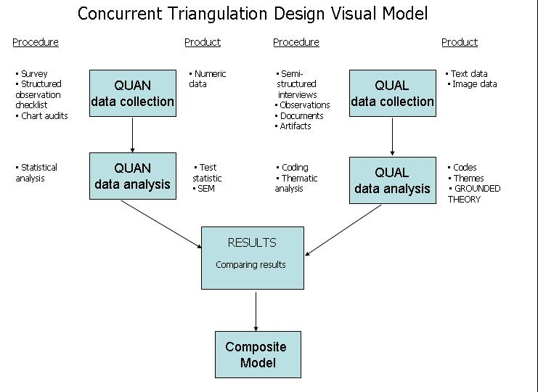
Example of
A Diagram

Slide 49
Inductive – Theory Building
Data → Models/Propositions → Theory
Deductive → Validation
Theory → Validation
Mixed Methods/Models
a) Inductive → Deductive
b) Deductive → Inductive
c) Inductive + Deductive
Define the problem
Itemise information needs
Research design – sample, methods, etc.
Data analysis
Findings
Recommendations & Conclusions

Slide 50
Quantitative start point
Generalization, abstraction, theory
Prediction, expectation, hypothesis
Deductive
reasoning
Inductive
reasoning
Findings
Observation, facts evidence
Observations, facts, evidence
Qualitative start point

Slide 51
Mixing or linking the data
Converge data:
Qual
Results
Quan
Connect data:
Qual
Quan
Results
Embed the data:
Quan data
Qual data

Slide 52
Concurrent Mixed Methods Designs
Triangulation Design
QUAN Data & Results
QUAL Data & Results
Interpretation
Embedded Design
QUAN Pre-test Data & Results
Intervention
QUAN Post-test Data & Results
Interpretation
qual Process

Slide 53
Sequential Designs Mixed Methods Designs
Explanatory Design
QUAN Data & Results
qual Data & Results
Interpretation
Following up
Exploratory Design
QUAL Data & Results
quan Data & Results
Interpretation
Building to
Sequential Embedded Design
QUAN Intervention
Trial
Before-intervention qual
After-intervention qual
Interpretation

Slide 55
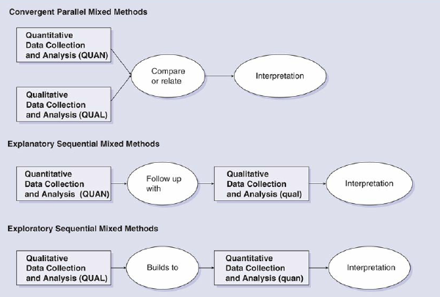
Three Basic Models of Mixed Research Design

Slide 56
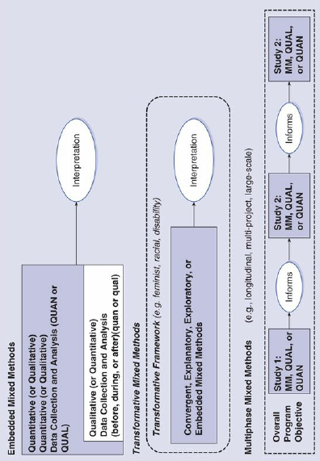
Advanced Mixed Methods Design

Slide 57
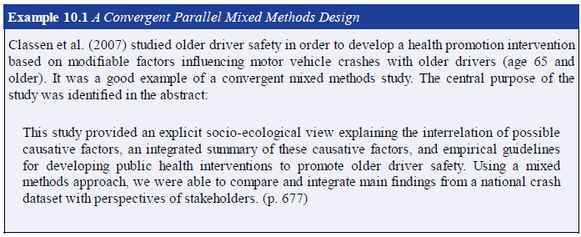

Slide 58
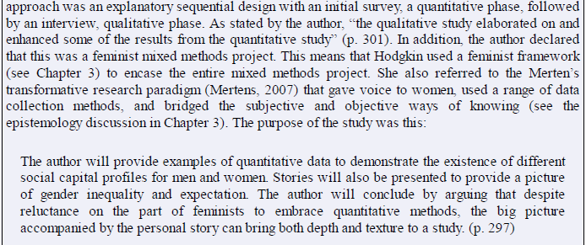

Slide 59
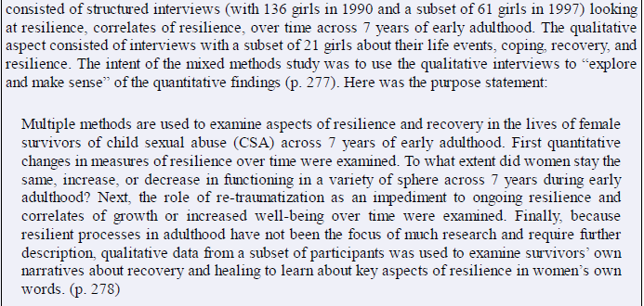

Slide 60
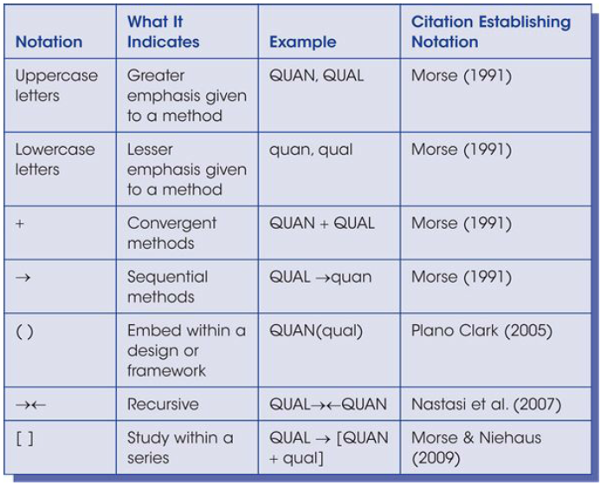

Slide 61
Design Notation
Design Name | Equal priority | QUAN emphasis | QUAL emphasis
Concurrent, triangulation | QUAL+QUAN | QUAN+qual | QUAL+quan
Concurrent, embedded | n/a | QUAN(qual) | QUAL(quan)
Explanatory, sequential, quan first | QUAN→QUAL | QUAN→qual | quan→QUAL
Exploratory sequential, qual first | QUAL→QUAN | qual→QUAN | QUAL→quan
Sequential, embedded | n/a | (qual) QUAN QUAN (qual) | (quan) QUAL QUAL (quan)

Slide 62
Mixing – Why?
Validity – to corroborate quan and qual data
Offset – offset weaknesses of quan and qual & draw on strengths
Completeness – more comprehensive account than one alone
Process – quan provides outcomes; qual, the processes
Explanation – qual can explain quan results or vice-versa
Unexpected results – surprising results from one, other explains
Instrument development – qual employed to design instrument
Credibility – both approaches enhance integrity of findings
Context – qual provides context; quan provides general.
Utility – more useful to practitioners
The insufficient argument – either method may be insufficient by itself
Multiple angles argument – each approach provide different “pictures”
The more-evidence-the-better argument – combined for more evidence
Community of practice argument – the preferred scholarly approach
Eager-to-learn argument – it is the latest methodology
“Its intuitive” argument – it mirrors “real life”

Slide 63
Mixed Methods Issues
How should mixed methods be defined?
Does the use of “quantitative” and “qualitative” in mixed methods create an artificial and unnecessary binary distinction?
What is driving the interest in mixed methods?
Is mixed methods a “new” approach?
Can we “mix” paradigms in mixed methods?
Does mixed methods privilege post-positivism?
Is there a dominant, meta-narrative discourse emerging in mixed methods?
Should there be a bilingual nomenclature for mixed methods?
Have to arrive at an understanding of types of research designs?
Is mixed methods claiming other designs as “their own” ?
What is the value added by mixed methods beyond conducting a quantitative or a qualitative study?

Slide 64
Some questions
I am collecting both quantitative and qualitative data my study, but am not calling it “mixed methods.” Should I?
What skills are essential for conducting a mixed methods study?
I have the qualitative skills, but really I am not competent in quantitative research, can I conduct a mixed methods study?
Not highlighted the importance of research questions that drive good research. Shouldn’t a person know their question before they choose their method?
Most journals in my field have a 3000 word limit. How can I publish my mixed methods study with such limitations?
Time/resources to conduct studies
Lack of understanding the methodology
Difficult to change research behaviors
Disagreements within the mixed-m community

Slide 65
Tracking empirical studies…
Selected Mixed Methods Studies in Trauma Research (Creswell & Zhang)
Authors (Year) | Journal | Topic | Quan Data | Qual Data | Integration | Impact Factor
Jones, Kafetsios (2005) | Clinical Child Psychology and Psychiatry | Political Violence and Psychological Well-being | HTQ and HSCL-25 | Open-ended questions and observations | Quan results are explored in a qual followup | 4.434
Monneuse et al. (2008) | Journal of the Surgeons | Attitudes about Injury among High School Students | Questionnaire | Open-ended questions | Quan results are explored in a qual followup | 3.101
Evans et al. (2007) | Journal of Traumatic Stress | Intrusive Memories Related to Violent Crime | Semi-structured interview | Semi-structured interview | Quan results are explored in a qual follow-up and vice versa | 1.884
Yassi et al. (2004) | Nursing Research | Factors Associated with Staff Injuries | Telephone survey | Interview and focus group | Qual findings help to develop or select quan instruments | 1.748
Feeney, Ylvisaker (2003) | Journal of Head Trauma Rehabilitation | Context-Sensitive Behavioral Supports for Young Children with TBI | MAS and ABCI | Interview of open-ended questions | Quan results are explored in a qual followup | 1.643
Banyard, Williams (2007) | Child Abuse & Neglect | Women’s Voice on Recovery from Child Sexual Abuse | Structured Interview | In-depth, open-ended interview | Quan results are explored in a qual followup | 1.506
Igreja et al. (2006) | The Journal of Nervous and Mental Disease | Women’s Posttraumatic Suffering After the War | HTQ and SRQ | In-depth interview | Comparison of the data sources | 1.496
Arditti (2003) | Journal of Loss and Trauma | Family Visiting at a Local Jail | Semi-structured interview | Semi-structured interview | Quan results are explored in a qual followup and vice versa | 0.528
Gaskell (2007) | Developmental Neurorehabilitation | Evaluating Rehabilitative Activity Holidays for Burn-injured Children | SDQ and Self-perception Profile for Children | Qual questionnaire | Comparing the data sources | NA
Notes:
65

Slide 66
What will hold mixed methods back?
Time/resources to conduct studies
Lack of understanding the methodology
Difficult to change research behaviors
Disagreements within the mixed methods community
What will push mixed methods forward?
Discipline expansion - unique discipline adoption
International expansion and cooperation - little “Atlantic gap,” little North American gap
Increased graduate student interests
Refinement and expansion of techniques
More advocates (and more critics)
The need for an empirical study of the value added by mixed methods to qualitative or quantitative 0

Slide 67
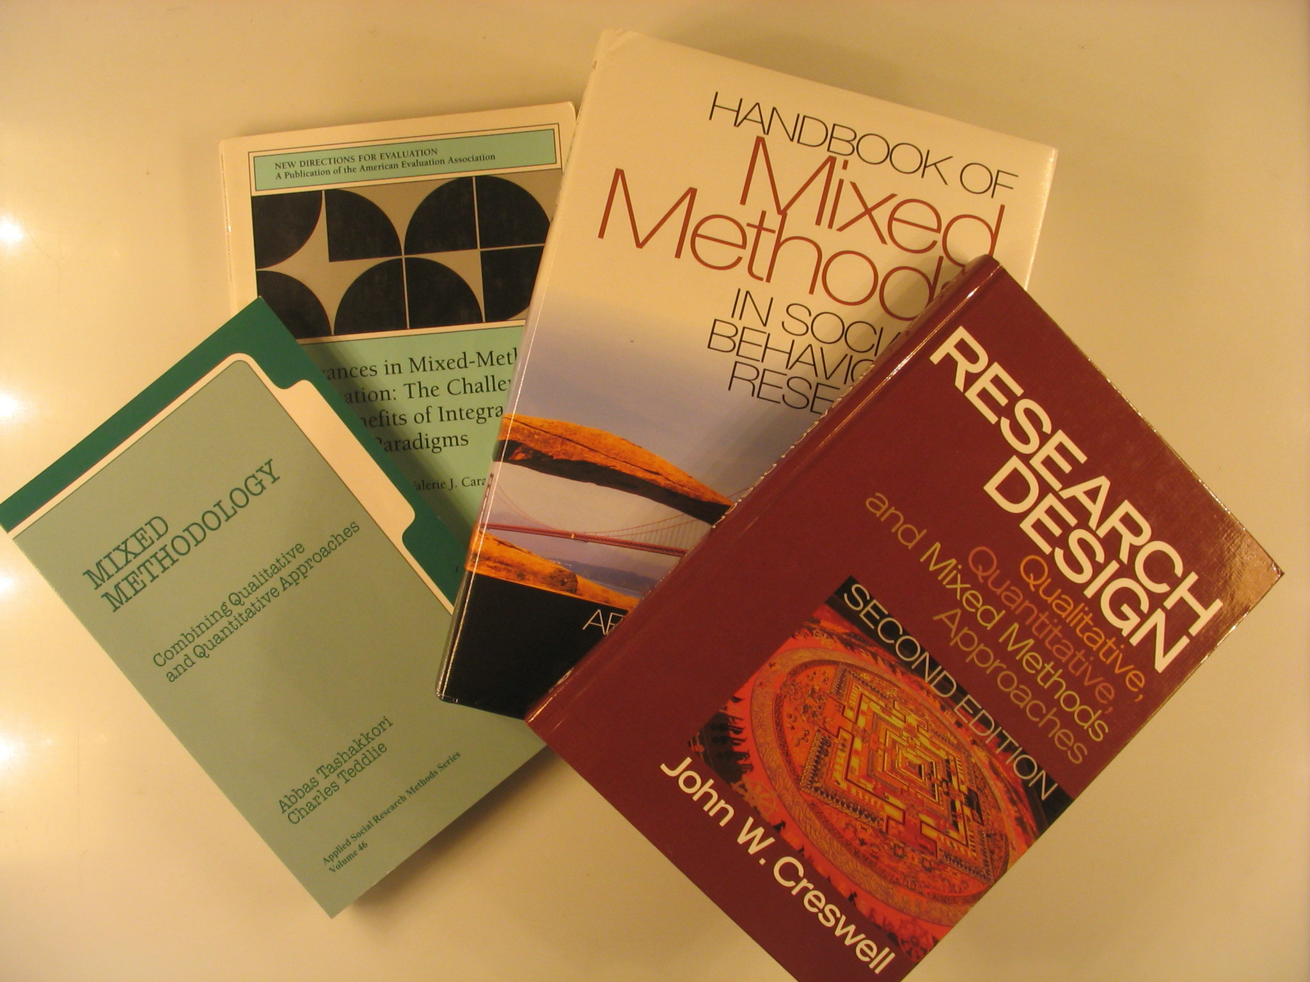
Books on
Mixed Methods
Research
14+ books on mixed methods research
have been written
since 1988

Slide 68
Founding Editors: John W. Creswell
and Abbas Tashakkori
Current Editors: Max Bergman
(Switzerland), Donna Mertens (USA)
Notes:
68

Slide 69
Importance of Credibility in Qualitative Research
Increasing Credibility
Using reflexivity
Doing things to increase the generalizibility of the study
Performing triangulation (appropriate for qualitative research)
Increasing the Quality of Studies
Be sure the categories generated in the interpretation are a good fit with the data
Clearly describe the life circumstances of the sample
Check interpretations against those of others
Explore whether the results are transferable to other people and contexts

Slide 70
Reliability and Validity
Can we trust that experiences are fairly similar from one context to another?
Do researcher interpretations include a detailed statement of reflexivity and are procedures clearly outlined with thick descriptions?
Effects of Participant Expectations and Researcher Bias
Both are potential challenges for qualitative research
Reduce participant expectations through careful planning (ie, interview questions); conduct a covert observation study (ethical concerns)
Reduce researcher bias with a detailed statement of reflexivity (interviews) or use of thick descriptions (observation studies)

Slide 71
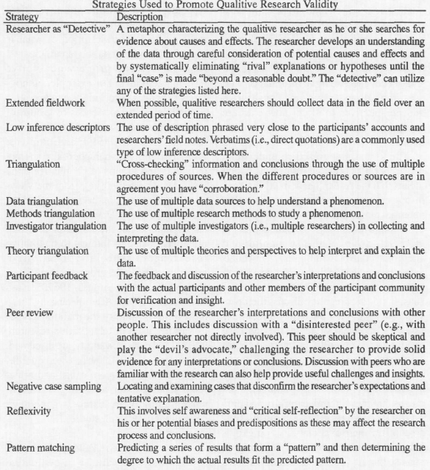

Slide 72
Triangulation
To give quality, credibility, and trustworthiness to a qualitative research, certain methods are used:
Triangulation
Saturation
Member checking
Self-disclosure (Reflexivity)
This is equivalent to reliability in a quantitative research
Triangulation involves using multiple data sources in an investigation to produce deeper understanding.
Methods triangulation - checking out the consistency of findings generated by different data collection methods.
For interviews, findings will be more robust and credible if your observations are backed up by comments that participants made in the interviews.

Slide 73
Saturation
How does a qualitative researcher know that he has collected enough data?
Theoretical saturation is the term used to describe the point at which no new information or concepts emerge from the data and when the themes or theories that have emerged from the data have been well-supported.
Usually based on personal comfort level of the researcher as well as contextual considerations regarding their resources and limitations.

Slide 74
Member checking
This is when data, analytic categories, interpretations and conclusions are tested with members of those groups from whom the data were originally obtained.
This can be done both formally and informally as opportunities for member checks may arise during the normal course of observation and conversation.
In this way, the participant can revise and clarify earlier statements
Typically, member checking is viewed as a technique for establishing to the validity of an account.

Slide 75
Self disclosure (Reflexivity)
While researchers may not be able to put aside their own beliefs, biases, and feelings about the area they are studying, they can be critical in their disclosure of those biases and in describing how those biases impact the study.
One way to foster reflexive research is by designing research that includes multiple investigators
This can foster dialogue, lead to the development of complementary as well as divergent understandings of a study situation and provide a context in which researchers' - often hidden - beliefs, values, perspectives and assumptions can be revealed and contested.

Slide 76
Triangulation
“ The use of two or more methods of data collection in the study of some aspect of human behavior ”
Cohen and Manion (2000)
The Effect of Triangulation on the Credibility Trustworthiness of Qualitative Research
Gives the results of qualitative research more depth
Use of multiple sources increases the credibility of data gathered with qualitative methods

Slide 77
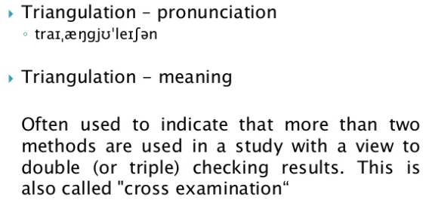
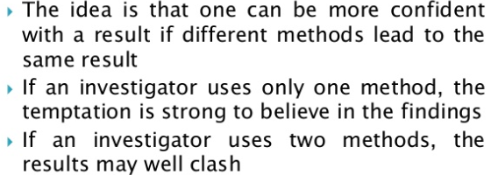
Triangulations – Basic Concepts

Slide 78
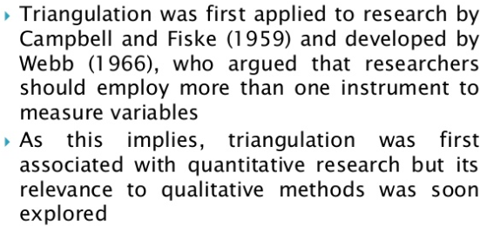

Slide 80
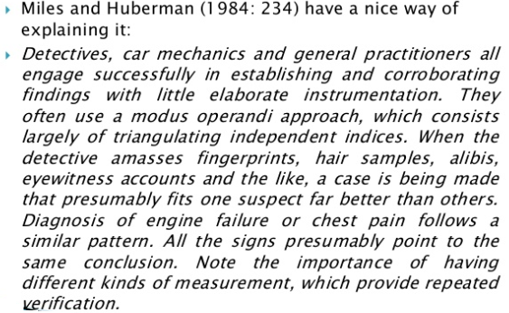
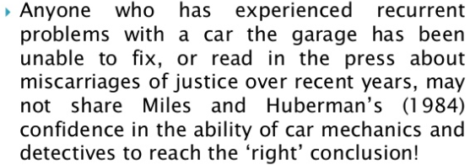

Slide 82
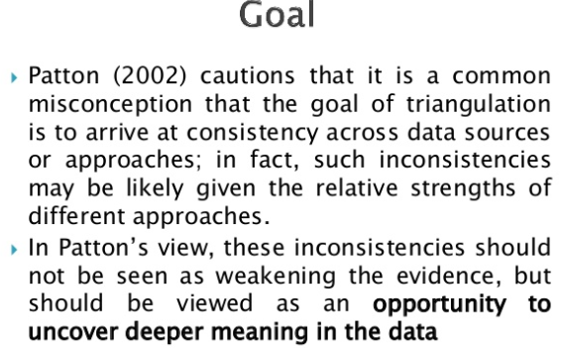
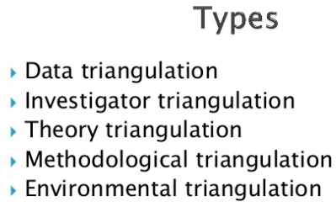

Slide 83
Types of Triangulation (for data gathered with qualitative methods)
Method triangulation
Data triangulation
Multiple analysis in triangulation
Theory triangulation
Member/respondent triangulation

Slide 84
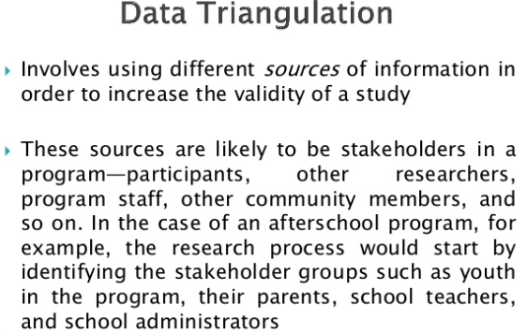
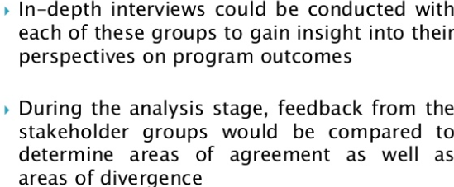
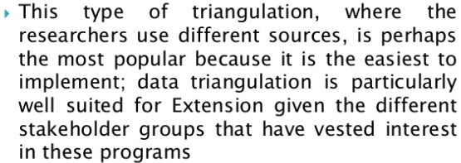

Slide 85
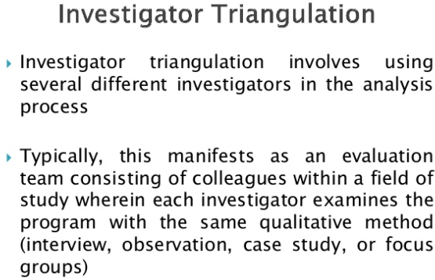
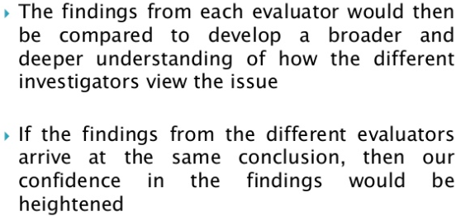
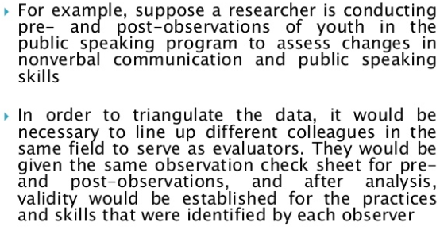

Slide 86
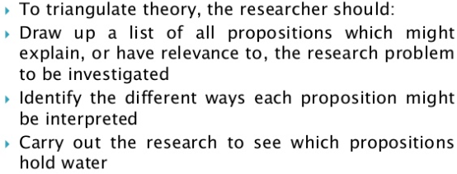

Slide 87
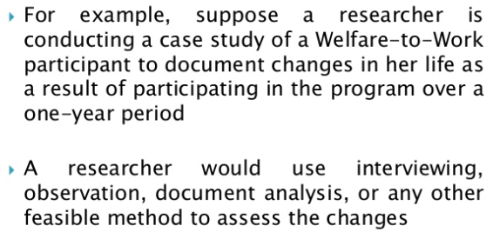
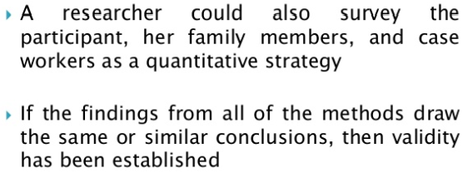

Slide 88
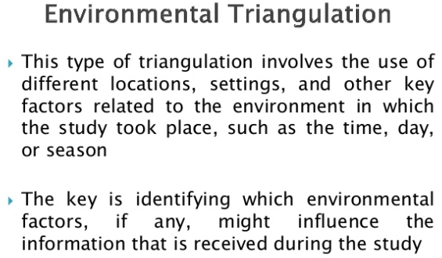
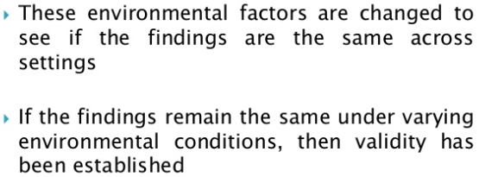
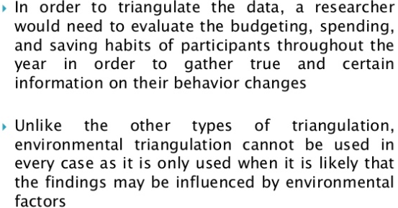
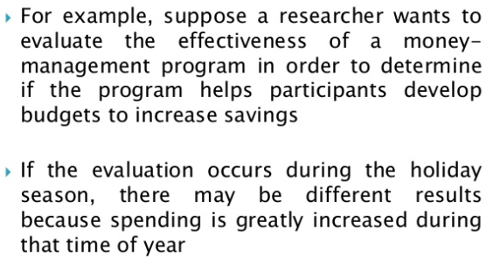

Slide 89
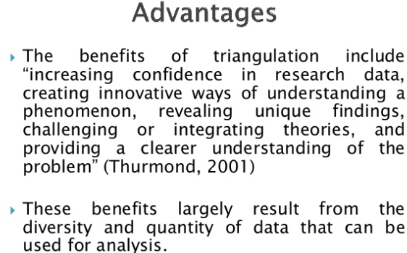
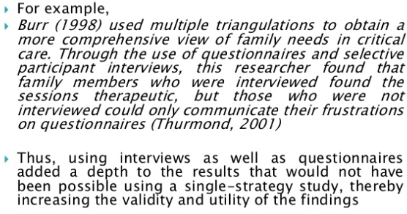

Slide 90
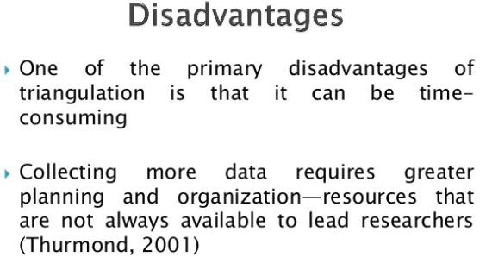

Slide 91
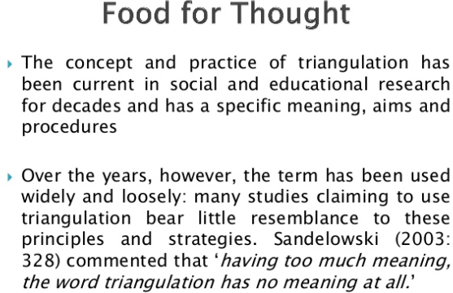
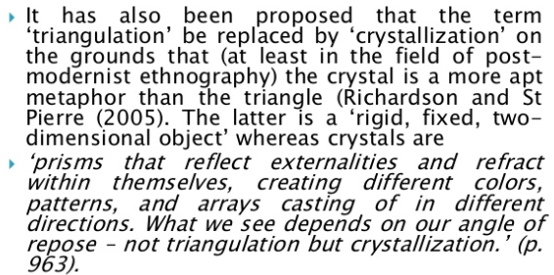

Slide 92
