Slide 1


IUT Logistics/Supply Chain: Contract Engineering,
Public-Private Partnership, Foreign Investments
1. Outsourcing, Procurement
2. Contract Type/Payments
3. Project Finance, Cashflow
3. Joint work, Partnerships
4. Private-Public Partnership
5. Iran Oil & Gas Contracts
Dr. Mehran Sepehri
Sharif University of Technology
September 19, 2019

Slide 2
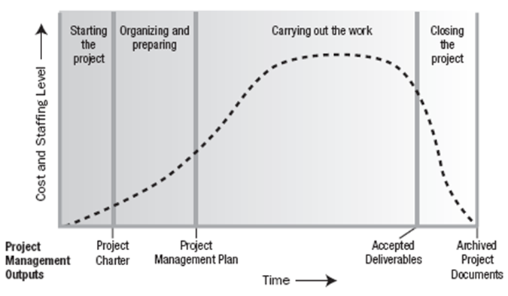
Projects
Temporary evedour for unique product/service

Slide 3

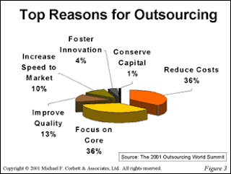
Outsourcing
Review
  “the strategic use of outside resources to perform activities traditionally handled by internal staff and resources” Griffiths
  Provide services that are scalable, secure, and efficient, while improving overall service and reducing costs
Make-Buy Decisions
Core competency
Strategic importance
Cost and volume
Speed and time
Quality
Idle/outside capacity
Confidentiality
Integration/Control

Slide 4
Procurement Management
Review
Requirement cycle: definition of the boundaries of the project
Requisition cycle: analysis of sources
Solicitation cycle: the bidding process
Award cycle: contractor selection
and contract agreement and award
Contract administration cycle: managing contractor until completion of the contract

Slide 5
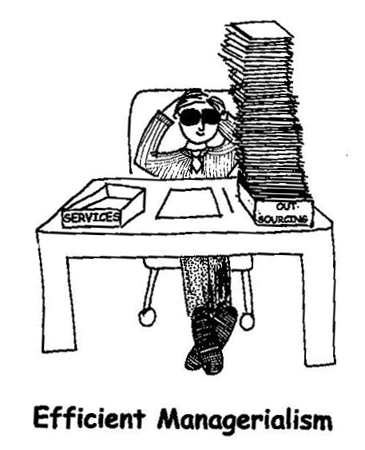
Problems With Outsourcing
Review
Loss of Control
Increased cash outflow
Confidentiality and security
Selection of supplier
Too dependent on service provider
Loss of staff or moral problems
Time consuming
Provider understand business
Slow to react changes in strategy

Slide 6
Supplier Selection & Evaluation
Examples of selection and evaluation criteria
Review
Cost
Quality & Safety
On Time Delivery
Service
Risk
Social Responsibility
Convenience/Simplicity
Agility
Policies
Regulations
Examples of Supplier Evaluation Method
Analytical Hierarchy Process
Weighted Point Method
Categorical Method
Cost Ratio Method

Slide 7
1. Requirement Cycle: Specification
Review
Design specifications: These detail what is to be
in terms of detailed and physical characteristics.
The risk of performance is on the buyer.
Performance specifications: Specifies measurable capabilities the end product must achieve in terms
of operational characteristics.
The risk of performance is on the contractor.
Functional specifications: The seller describes the
end use of the item to stimulate competition among commercial items, at a lower overall cost.
The risk of performance is on the contractor.

Slide 8
4. Award Cycle
Review
The objective of the award cycle is to negotiate a contract type and price that result in reasonable client/contractor risk and provide client/contractor with the greatest incentive for efficient and economic performance.
Fixed price contract
Cost plus contract
Unit rates contract

Slide 9
Contract’s Risk and Reward Go Hand-in-Hand
Review
HIGH
LOW
Risk On Client
FFP
CPFF
Risk On Contractor
LEGEND
FFP FIRM FIXED PRICE
CPFF COST PLUS FIXED FEE

Slide 10
Firm-Fixed-Price Contract (FFP)
Review
Maximum risk with contractor
Higher negotiated profit margins
High likelihood of scope changes
100 %
RISK SHARING METER
0 %
CONTRACTOR’S
RISK
RISK
CUSTOMER’S
RISK
0 %
LOCATION
100 %

Slide 11
Firm-Fixed-Price with Economic Price Adjustments (FPE)
Review
Adjustments for escalation factors
Adjustments for inflation
Negotiated adjustment cycle
100 %
RISK SHARING METER
0 %
CONTRACTOR’S
RISK
RISK
CUSTOMER’S
RISK
0 %
LOCATION
100 %

Slide 12
Cost-Plus-Fixed-Fee Contract (CPFF)
Review
All costs are reimbursed (cost run-ups)
Fee is fixed (in $$$ not %) irrespective of costs
Contractor is motivated for early completion
100 %
RISK SHARING METER
0 %
CONTRACTOR’S
RISK
RISK
CUSTOMER’S
RISK
0 %
LOCATION
100 %

Slide 13
Cost-Plus-Incentive-Fee Contract (CPIF)
Review
Contractor can earn additional profits
All costs are reimbursed (cost run-ups)
A “floor” and “ceiling” exists on profits
100 %
RISK SHARING METER
0 %
CONTRACTOR’S
RISK
RISK
CUSTOMER’S
RISK
0 %
LOCATION
100 %

Slide 14
Principles of Incentive Contracts
Review
Customer pays 80 % of overrun
Contractor pay 20 % of overrun
Profit is $1500 less
EXAMPLE
CONTRACTOR’S 20 %
TARGET COST: $20,000
TARGET FEE: $1500
SHARING RATIO: 80/20 %
Customer keeps 80 % of underrun
Contractor keeps 20 % of underrun
Profit is $1500 plus
CONTRACTOR’S 20 %
Note: limitations may be imposed on price or profit

Slide 15
Relative Contract Risk
Review
RISK SHARING METER
0 %
100 %
FFP
RISK
FFE
RISK
FPIF
CONTRACTOR’S
CPIF
CUSTOMER’S
CPAF
CPPC
CPFF
RISK
LOCATION
CS
0 %
C
100 %

Slide 16
Projects: Temporary endeavor
Review
Top Reason
delays/failure

Slide 17

Project Finance: Outsourcing Finances
  Corporate Finance
Project finance

Slide 18
Project Finance
  Corporate Finance
Based on Debt
Based on Investment
Project finance

Slide 19
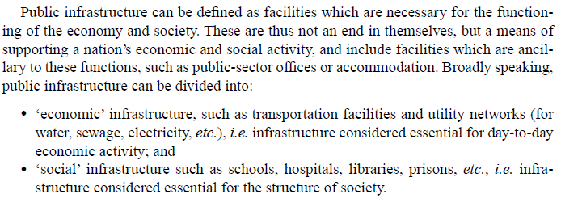
Infrastructure Projects
Review
Hard Infrastructure: Powerplant. Soft Infrastructure: Health

Slide 20
Projects
Temporary evedour for unique product/service

Slide 21

Partnership
A partnership is an arrangement
where parties, known as partners,
agree to cooperate to advance the
mutual interests.
A Partnership is usually governed
by a contract between the parties.

Slide 22
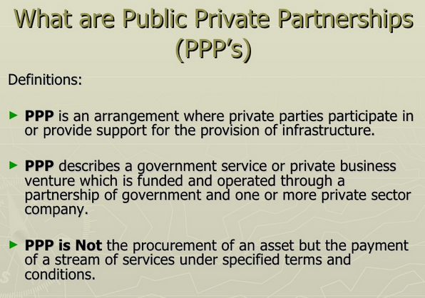
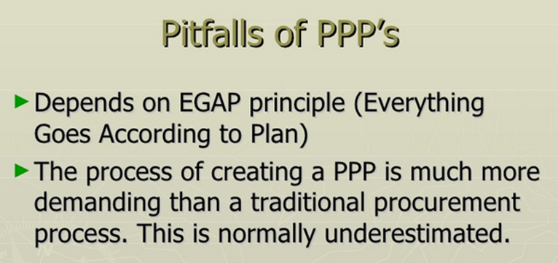

Slide 23
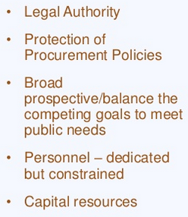
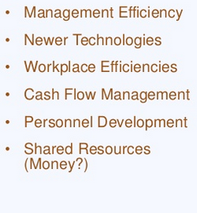

Public Sector Strength
Private Sector Strength

Slide 24
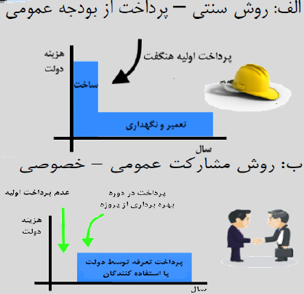
1- Traditional: Paying from Public Budget
Pay All by Public
Public
Cash
Flow
Construction
Operations/Maintenance
Time
2- Using Private-Public Partnership (PPP)
Pay by Private
Pay by Private
Public
Cash
Flow
Return from Fees
and Loyalties
Time

Slide 25
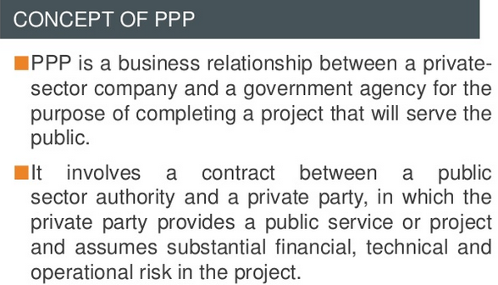
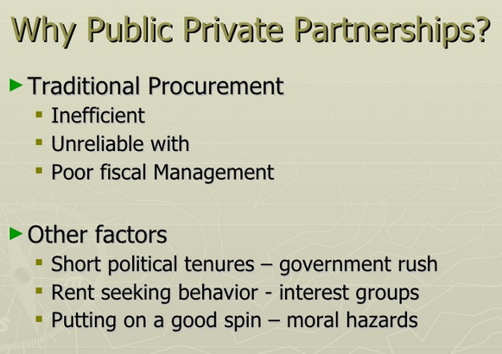
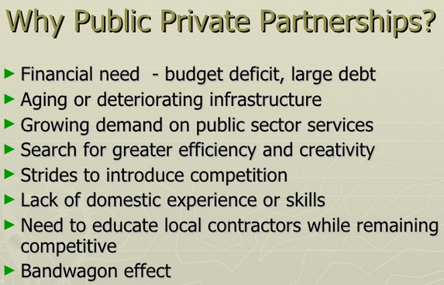
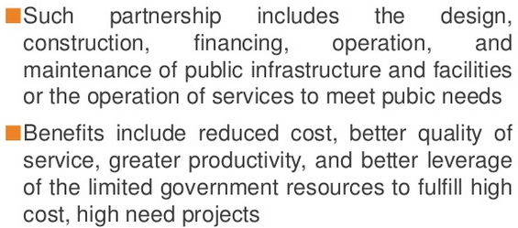

Slide 26
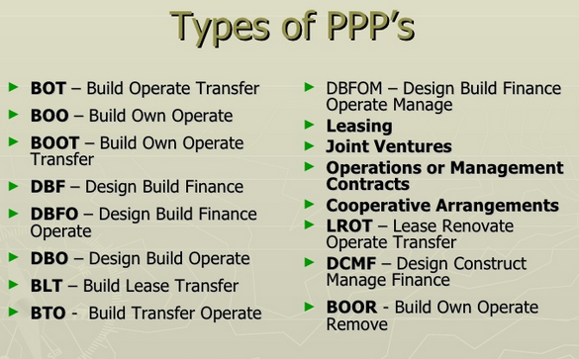
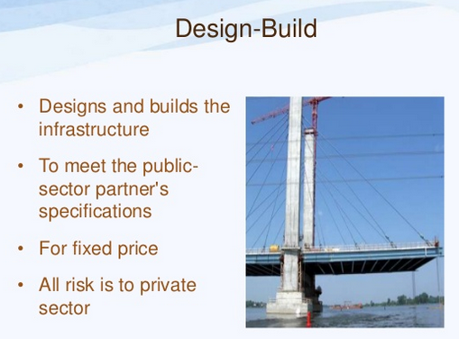
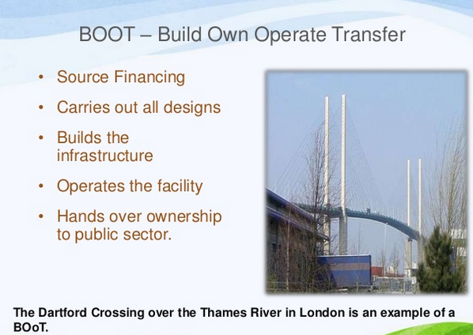

Slide 27
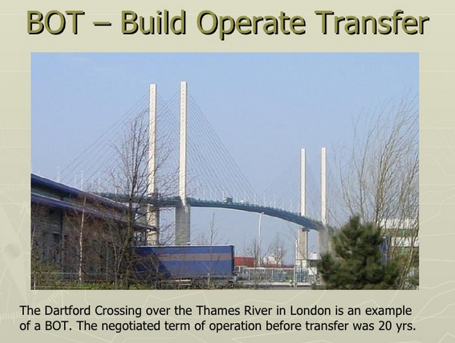
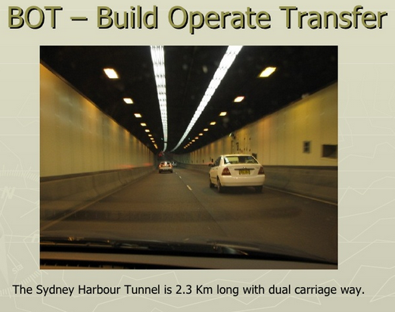
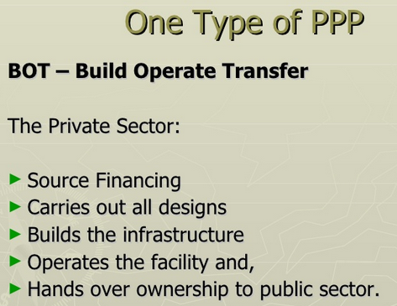

Slide 28
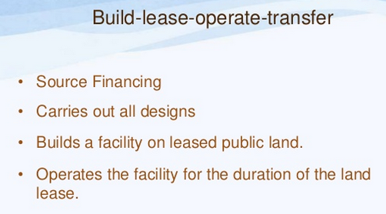
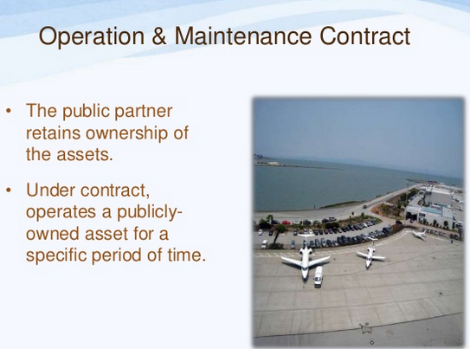
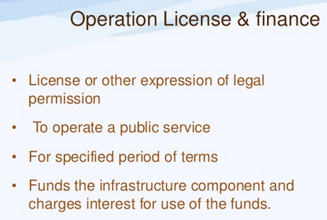
Alternative PPPs

Slide 29
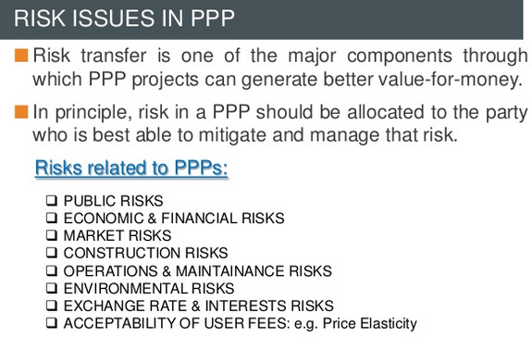

Slide 30
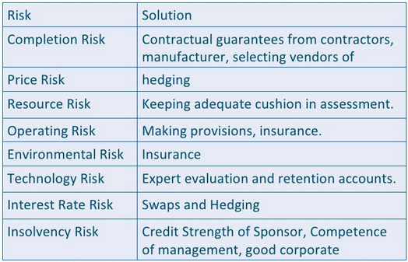
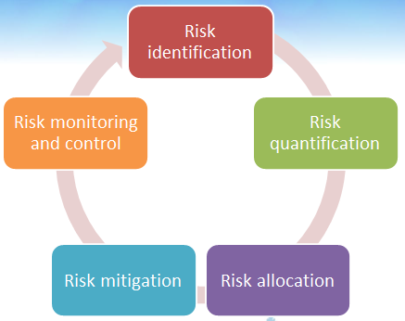
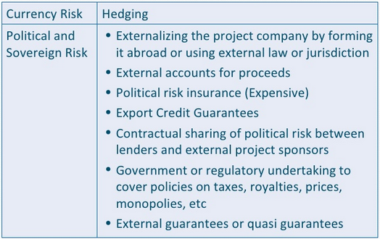
Risk
Identification
& Mitigation

Slide 31
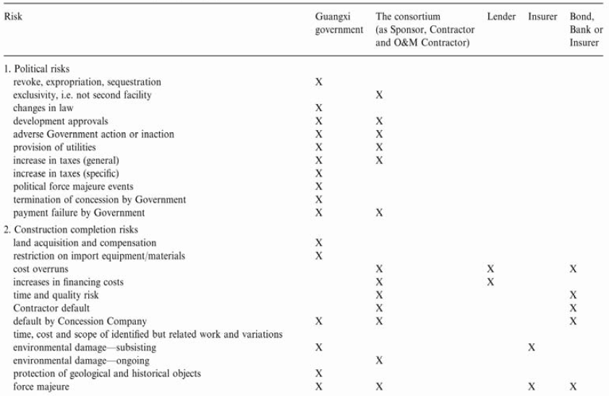
PPP Risk Sharing

Slide 32
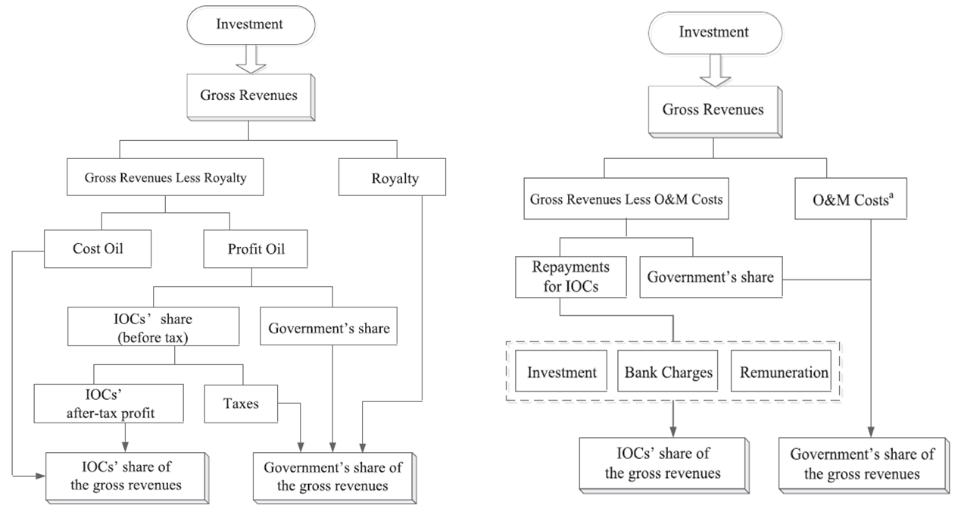
B. Iranian Petroleum Contracts (IPC)
Production
Sharing
Contracts
Buy-back
Contracts

Slide 33
New IPC (20+ years) Development & Production

Slide 34

Sharing Risks and Benefits
IRR
COM
Production Targets
Cost
Over Run
DCC Distribution
DCC/IDC
Production
profile
OPEX
Contract period
Amortization period
Market Risk (Oil/Gas Price)
Delay
Fee

Slide 35
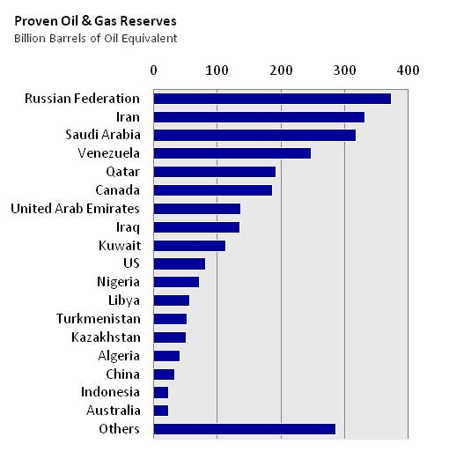
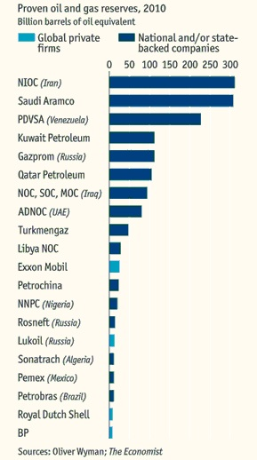
The Industry in Numbers: Reserves
By Country
By Company
Source: BP Statistical Review
Total > 2.7 Trillion Barrels of Oil Equivalent

Slide 36
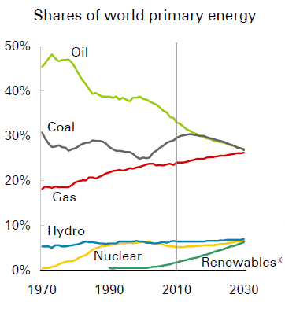
The Industry in Numbers: Production
By Source
The three fossil fuels are converging on market shares of 26-27%. Increasing importance of natural gas.

Slide 37
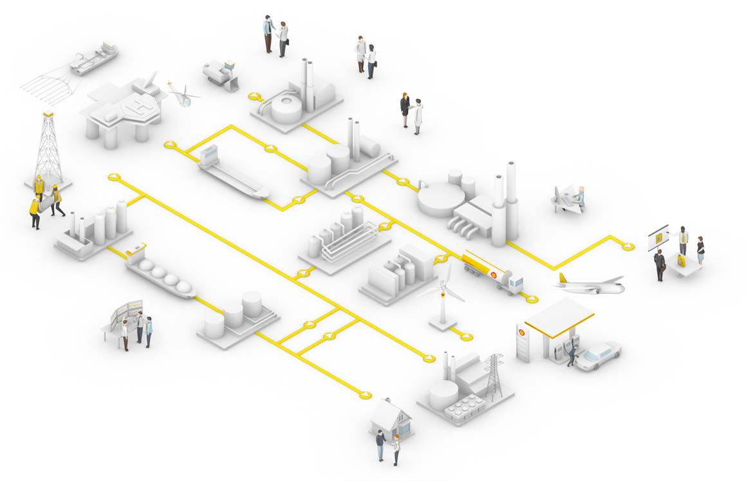
Oil & Gas Industry Segmentation
Upstream Sector

Slide 38
Oil & Gas Business Cycle
Licensing
Prospect
Exploration
Drilling
Production
Drilling
Downstream
Negotiation with Governments / Individuals (US)
Different types of contracts: royalties, PSA, service contract, etc
Geological characteristics
Seismic evaluation
Infrastructure set-up .
Uncertainty
Analysis of formations and hydrocarbon characteristics
Full scale project
Field optimization
Definition of drilling program and well profiles
Onshore / Offshore

Slide 39
Merits and Demerits of
Different Types of Petroleum Contracts
There is no consistent approach to the establishment or implementation of international agreements/fiscal systems.
Each country establishes the type of agreements/fiscal systems those best meet their sovereign need.
Petroleum is strategic material so the understanding of agreements/fiscal systems for Int’l E&P is very important.

Slide 40
History of Oil& Gas Contracts
Concession is originated from the E&P of petroleum in developing countries by international oil companies, dated from late of 19th century-under political control of European power.
Production sharing contract was first employed by Indonesian GOE and a foreign oil company in 1966-under antipathy of people for foreign company and desire to control its national resources.
Service Contract was first introduced by Argentine government in 1958 in 3 types: drilling, development, exploration/production
financially unstable to obtain most advanced technology.
Joint venture is introduced by Italian GOE, ENI and Egyptian and Iranian GOE in 1957-to participate in managerial decision.

Slide 41
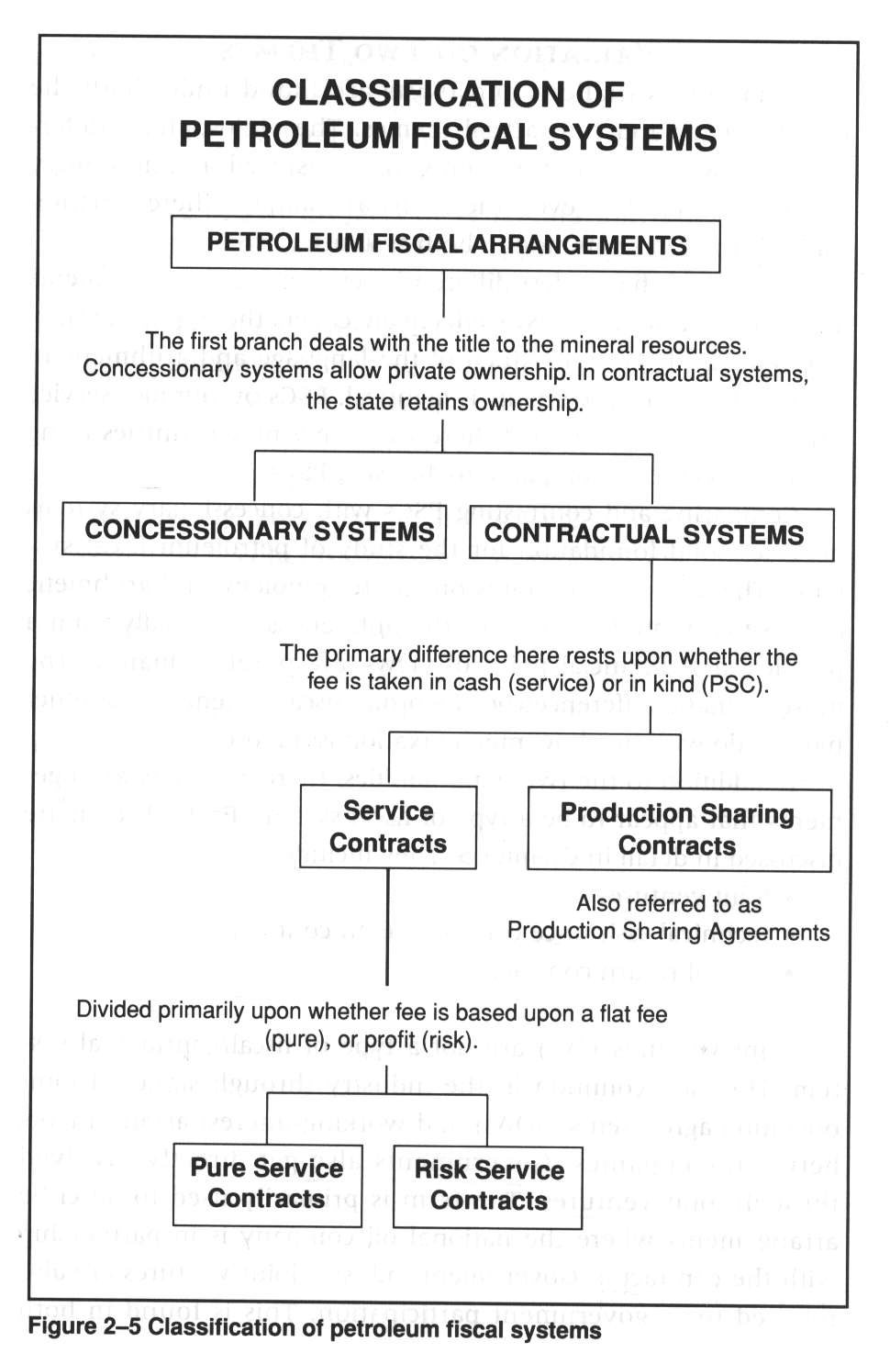
ㅇ

Slide 42
Concession Agreement
Concession Agreement(Royalty/Tax) grants ownership of petroleum.
Traditional concession is simple agreement consisted of only royalty (12.5%) payment based on the tonnage of crude oil produced in very large area with unreasonably long period.(50-60yrs)
Modern Concession grants a fixed period: exploration (3-5yrs), exploitation (30-40yrs). Government revenue is deprived mainly
from royalties (11.5-14.5%) and net income or taxes.

Slide 43
Production Sharing Contract
PSC doesn’t grant ownership, only grant right to receive a share of production or revenues from the sale of oil and gas.
Government revenue is composed of Government profit oil and Taxes.
TOTAL
OIL
PRODUCED
ROYALTY
COST
RECOVERY
OIL
COST
COMPANY
PROFIT
CONTRACTOR
SHARE OF
PROFIT OIL
GVT. TAKE
Corp. tax
PROFIT
OIL
GOVERNMENT
SHARE OF
PROFIT OIL

Slide 44
Joint Venture
Joint venture involves joint ownership of assets and concession rights, a sharing of certain costs of operation, and net revenues.
In joint venture, the private company is always designated as the operator, but GOE usually participate in management through a joint management committee, approves work program and budget.
Joint venture is not only contracted between company and government but also company to company.
Joint venture can be found in Concession and PSC.

Slide 45
Service Contract
Service contract is one under which a private company agrees to perform certain specified services for the government or a GOE in return for fixed payment(pure service, Technical Service Agreement, which have money but lack of the technical know-how) or probable profits(risk service).
The difference between service and PSC is nature of payment-Cash or Crude.

Slide 46
Conclusion
Concession agreement is generally used by the countries those are non producer and new comer in oil industry and want to encourage foreign investment in the development of their oil resources. So government grant ownership and make terms attractive to the investor.
PSC is generally used by the countries whose people is very hostile to foreign companies (formerly ruled by other countries) and want to participate more actively in E&P, refinery, marketing and distribution.
Service contract is same as PSC except the fee is paid by cash.
Joint Venture is used by who want spread risk or short of capital and used in both concession and PSC.
There is no superiority of contracts actually. The most important factor to determine the economic success is the structure of fiscal system(royalty, tax, cost recovery, etc) and the flexibility(ex. sliding scale, R factor) is becoming standard and beneficial to the host government and contractors.

